Slide 1
ITIL® 2011 Foundation Certification Course
Unit 4—Service Transition

Slide 2
Service Transition
Lesson 1—Introduction to Service Transition

Slide 3
Objectives
Describe the purpose, objective, scope and value of service transition
Explain Configuration Item (CI) and Configuration Management System (CMS)
After completing this lesson, you will be able to:

Slide 4




Service Transition—Purpose
Service transition phase verifies whether the new or changed services meet the functional and technical criteria.
The purpose of service transition is as follows:
It ensures that new or modified services meet the business expectations.
It helps to move services from design to operations, without affecting the ongoing services.
Purpose
Objective
Scope
Value

Slide 5



Service Transition—Objective
The objective of service transition is to:
plan and manage changes in service changes effectively;
manage risks associated with new or modified services;
deploy service releases into supported environments successfully;
set the correct expectations on performance and use of new or changed services; and
provide quality information on services and service assets.
Purpose
Objective
Scope
Value

Slide 6
Service Transition—Scope
The scope of service transition includes:
the development and improvement of capabilities for the transition of new and modified services into supported environments.
considering service retirement and transfer of services from one service provider to another.
Purpose
Objective
Scope
Value

Slide 7
Service Transition—Value for Business
Service transition offers the following values to a business:
The business develops the capacity to respond quickly and adequately to changes in the market.
The changes in the business are well-managed.
The business experiences more successful changes and releases.
There is better compliance of business and governing rules.
There is less deviation between planned budgets and actual costs.
The business has better insight on risks.
Purpose
Objective
Scope
Value

Slide 8
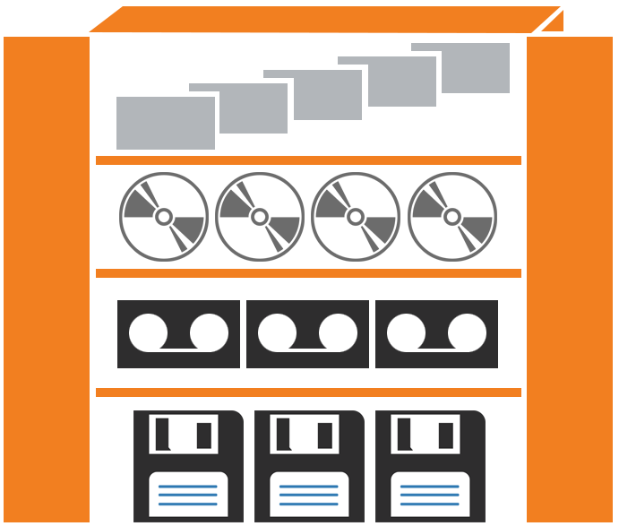
Configuration Item
Configuration Item is any component that needs to be managed to deliver an IT service.
CI is recorded in a configuration record within the Configuration Management System. The record includes a unique identifier and the location of the CI.
CIs include IT services, hardware, software, buildings, people and formal documentation.
CIs are controlled by configuration management and are subject to formal change control.

Slide 9
Configuration Management System
CMS is a set of tools and databases used to manage the configuration data of an IT service provider.
Information about all configuration items:
CI may be an entire service, or any component
Stored in 1 or more Configuration Management Databases (CMDBs)
CMS stores attributes:
Any information about the CI that might be needed
CMS stores relationships:
Between CIs
With incident, problem, change records, etc.
CMS has multiple layers:
Data sources and tools, information integration, knowledge processing (scorecards, dashboards, etc.) and presentation

Slide 10
Summary
Service transition ensures whether new, modified or retired services meet the business expectations as documented in the service strategy and service design stages of the lifecycle.
Configuration Item is any component that needs to be managed to deliver an IT service.
The Configuration Management System is a set of tools and databases used to manage the configuration data of an IT service provider.
Here is a quick recap of what we have learnt in this lesson:

Slide 11
Service Transition
Lesson 2—Service Transition Processes

Slide 12
Objectives
Describe the purpose, objective and scope of transition, planning and support
Explain the purpose, objective and scope of change management
Describe the concept of Service Asset and Configuration Management (SACM)
Identify the purpose, objective and scope of Release and Deployment Management
Explain the purpose, objective and scope of knowledge management
After completing this lesson, you will be able to:

Slide 13
Introduction to Service Transition Processes
The processes in Service Transition phase are critical as they influence and support all stages of the service lifecycle. The processes include:
Transition, planning and support
Service asset and configuration management
Release and deployment management
Change management
Knowledge management
Provides plan and support for new or modified services and ensures orderly transition of services.
Controls the lifecycle of all changes and ensures balance between flexibility and stability.
Provides the required information to manage CIs and assets across the service lifecycle.
Plans, builds, tests the releases and deploys the services into customer environment.
Gathers information, analyses and shares it with the organisation to increase efficiency for future.

Slide 14



Transition, Planning and Support—Purpose
Transition, planning and support is a process that includes planning and coordination for the activities involved in service transition.
The purpose of transition, planning and support process is to:
provide overall planning for service transitions; and
coordinate the resources that are required to deliver the service.
Purpose
Objective
Scope

Slide 15
Transition, Planning and Support—Objective
The objective of transition, planning and support is to:
plan and coordinate the resources for effective service delivery;
coordinate activities across projects, suppliers and service teams;
provide clear plans to align activities with the service transition plans;
establish new or modified information systems and tools, technology; and
review and improve the performance of service transition.
Purpose
Objective
Scope

Slide 16
Transition, Planning and Support—Scope
The scope of transition, planning and support is to:
maintain policies, models and standards for the activities and processes in service transition;
coordinate the efforts needed to manage several transitions at the same time;
prioritise conflicting requirements for service transition resources; and
review and improve the performance of activities related to transition planning and support.
Purpose
Objective
Scope

Slide 17
Introduction to Change Management
A change is a modification, addition, or removal of anything that could impact IT services. This includes addition, modification or removal of approved, supported or base lined hardware, network, software, application, environment, system, desktop build or associated documentation.
Reasons for Change
Proactive
Reactive
Cost reduction
Solving service disruptions
Service improvement
Service adaption

Slide 18
Change Management—Purpose
Change management covers changes to baselined service assets and configuration items across the whole service lifecycle.
The purpose of change management process is to:
control the lifecycle of all changes; and
help in making beneficial changes with minimum disruption to IT services.
Purpose
Objective
Scope

Slide 19
Change Management—Objective
The objective of change management is to:
respond to business and IT requests to ensure alignment of services with business needs;
ensure that changes are introduced in a controlled manner, thus optimising business risk.
implement changes timely and successfully to meet business needs; and
use the standard processes and record every change.
Purpose
Objective
Scope

Slide 20
Change Management—Scope
The scope of change management includes:
any changes to all architecture, tools, metrics, processes and documentation;
addition, removal or modification of a service or a Configuration Item or an associated documentation; and
changes to any of the five aspects of service design.
Purpose
Objective
Scope

Slide 21
Change Model
A change model refers to pre-defined set of steps, policies and procedures for assessing, authorising and executing a specific type of change. Change models should include the following:
The steps to handle the change
The chronological order of the steps
Defined roles and responsibilities
Thresholds and timescales for completion of the actions
Escalation procedures

Slide 22
Types of Change
The three change types are mentioned below:
Change Types
Normal
Standard
Emergency
It follows all the steps of the change process. It is assessed by the Change Manager and approved by Change Advisory Board.
It is a pre-approved change that has low risk and follows a defined procedure or work instruction.
It is a change that must be addressed quickly. Advanced processes are used to handle such changes.

Slide 23
Key Terminologies
Following are a few key terms related to service transition:
Remediation planning: It refers to a recovery plan to a known state after a failed change or release.
Service change refers to the addition, modification or removal of an authorised, planned or supported service component and its associated documentation.
Request for change (RFC): It is a formal request for a service change and it can be raised or issued by anyone involved in the service.
Change proposal: It is raised for major changes with significant organisational or financial effects.
Notes:
<

Slide 24
Change Proposal
A change proposal is utilised to communicate a high-level description of any change that has occurred. It may include multiple changes that are passed to change management.
Created by
Passed to
Change proposal
Service portfolio management
Change management
Includes
Description of new, changed or retired service
Business case
Financial requirements
Outline schedule for design and change implementation

Slide 25
Change Management Process—Change Flow
The image represents the different activities in a change management process.
Record the RFC
Review the RFC
Assess and Evaluate the
Change
Update Information on Relevant CIs in the CMS
Authorise the Change
Coordinate
Implementation
Review and Close the
Change Record

Slide 26
Change Management—Example
Q
A small organisation has the following Configuration Items (CIs): 10 Windows and 2 email servers, 20 switches, 5 routers, 2 video conferencing units. The two email servers (server 1 and server 2) are the parents for the routers, namely, router 1 and router 2, which are parents for all the switches. The remaining servers and routers are serving for a different service. There is a firmware upgrade requested by the server team on the server. The flowchart shows how change management is implemented.
Change is acknowledged
Initial validation
User raises change
Change raised
CR is logged
CHM validates the CR for complete information
Understanding the reason and affected CIs
CR reason is to have the updated firmware
Linked CI's: rout1, rout2, and switches
Firmware Version -7.1
Expert view on change
Seek an expert’s view from the technical team
Seek an expert’s view from the technical team
Seek an expert’s view from the technical team
Risk management of the change
Risk identification
Server may not restart
Firmware compatible issue for other CI's
Business impact and remediation plan
BI Analysis if the change fails
All the email users will be affected
Remediation plan: Uninstall the patch
CAB initiation
Approval from CHM Manager
Approved
CHM Manager hosts a cab call
Change implementation
Change is approved and moved to release
Date finalised for release
Release implemented
Change confirmation
CHM verifies the release
Release successful
CR is closed

Slide 27
Change Advisory Board
Change Advisory Board (CAB) is a consultative body that helps the Change Manager assess, prioritise and schedule the changes. The Change Manager chairs the CAB, and the board may include the following representatives:
technical support;
operations;
development;
service management;
customers;
other stakeholders; and
third parties.
!
Emergency CAB is a subset of the CAB organised by the Change Manager to advise on emergency changes.

Slide 28
Change Manager—Responsibilities
Following are the key responsibilities of the Change Manager:
Change Manager
Ensures process is followed and authorises minor changes.
Identifies key stakeholders, coordinates and runs CAB meetings.
Produces change schedule.
Coordinates change, build, test and implementation.
Reviews or closes changes.
Initiates post implementation review meetings.

Slide 29

7 R’s of Change Management
For proper impact assessment and understanding of benefits to risk, answers to the following seven questions are important.
Who raised the change?
What is the reason for the change?
What is the return required from the change?
What are the risks involved in the change?
What resources are required to deliver the change?
Who is responsible for the build, test and implementation of the change?
What is the relationship between this change and other changes?

Slide 30
Change Metrics
A metric is measurable and reported to help manage a process, IT service or activity. Key Performance Indicators (KPIs) are selected to manage efficiency and effectiveness.
Metrics
Compliance | Decrease in unauthorised changes Decrease in emergency changes Maintain the integrity of the CI’s and change
Effectiveness | Increase in percentage of changes implemented Decrease in disruptions, defects and re-work Decrease in changes failed There should be a decrease in the quantity of incidents attributable to any change.
Efficiency | Benefits gained Average time to implement Increased percentage of accuracy in change estimates
Notes:
ss.

Slide 31

Key Challenges in Change Management
The key challenges faced by change management are:
business pressure;
incomplete and inaccurate Configuration Management System;
soiled technical function areas;
misunderstanding of emergency changes;
scalability across large organisations; and
vendor or contract compliance.

Slide 32
Service Asset and Configuration Management—Purpose
Service Asset and Configuration Management (SACM) process manages the service assets to support the other service management processes.
The purpose of SACM is as follows:
Ensure the assets required to deliver services are properly controlled.
Store accurate and reliable information about the assets.
Ensure that the information is available anytime.
Purpose
Objective
Scope

Slide 33
Service Asset and Configuration Management—Objective
The objective of SACM is to:
define and control the components of infrastructure and services;
maintain exact configuration records.
Purpose
Objective
Scope

Slide 34
Service Asset and Configuration Management—Scope
The scope of SACM is as follows:
Ensure all assets used during the service lifecycle are within the scope of asset management.
Manage the complete lifecycle of every configuration item.
Purpose
Objective
Scope

Slide 35
provides the information required to manage CIs and assets across the service lifecycle.
Knowledge Management
Service Asset and Configuration Management
Service Portfolio Management
Business Relationship Management

Slide 36
provides the information required to manage CIs and assets across the service lifecycle.
Knowledge Management
Service Asset and Configuration Management
Service Portfolio Management
Business Relationship Management
Answer: b.
Explanation: Service asset and configuration management provides the information required
to manage CIs and assets across the service lifecycle.

Slide 37
Configuration Baseline and Database
A configuration baseline is the configuration of a service, product or infrastructure that is formally reviewed and agreed on. A configuration baseline:
captures the structure, contents and details of a configuration; and
represents a set of configuration items that are related to each other.
A Configuration Management Database is a database to store records of CIs.
The CMDB provides a logical model of the IT infrastructure.
Similar to the CMDB, there are two libraries as part of the Configuration Management System.

Slide 38
Configuration Management—Example
Q
A leading organisation has the following Configuration Items (CIs). Identify the attributes to be stored in CMDB.
S/N | Configuration Items | Numbers
1 | Servers | 20
2 | Routers | 40
3 | Switches | 50
4 | Voice Gateway | 10
5 | Video Conferencing Units | 15
Server | Server name, server IP, server model, Server Make, OS, Serial Number, Support Date, Dependencies
Router | Router name, router IP, Router Model, Router Make, Firmware Version, Serial Number, Support Date, Interface Name, BW allocation, Dependencies
Switch | Switch Name, Switch IP, Switch Model, Switch Make, Serial Number, Support Date, Dependencies
Voice GW | Voice GW Name, Voice GW IP, Voice GW Model, Voice Gateway Make, Serial Number, Support Date, Dependencies
Video Conference | VC Name, VC IP,VC Model, VC Make, Serial Number, Support Date, Dependencies, Firmware Version

Slide 39
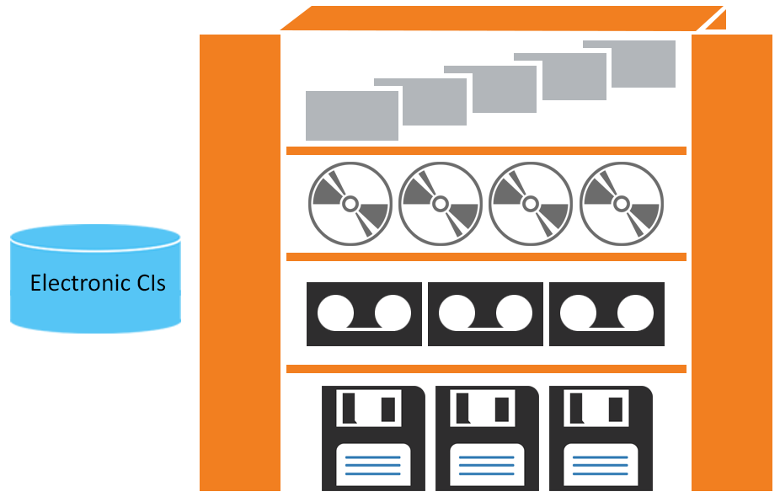
Definitive Media Library
The Definitive Media Library (DML) is a secure store where the definitive, authorised and approved versions of all media CIs are stored and monitored.
DML is the only source for build and distribution.
The master copies of items pass quality assurance checks.
DML includes master copies of all software assets such as scripts, codes, licenses and so on.
© Crown Copyright 2011. Reproduced under licence from AXELOS.

Slide 40
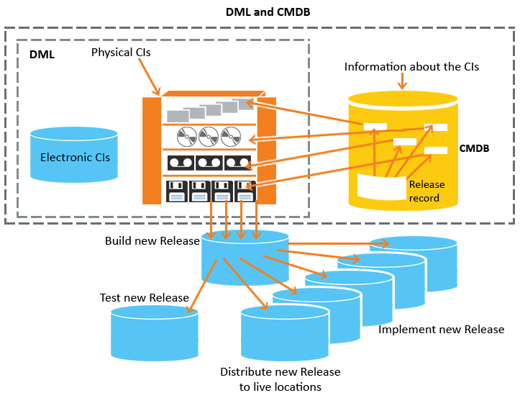
CMDB and DML
The image illustrates the relationship between the concepts of CIs, CMDB and Definitive Media Library. It also explains how they are used to roll out new releases and deployments to the live environment.
© Crown Copyright 2011. Reproduced under licence from AXELOS.

Slide 41
Secure Library and Secure Stores
Secure library is a collection of software, electronic or document CIs of known type and status.
A secure store is a secure location where IT assets like PCs, server and other hardware are stored.
Definitive spares are spare components and assemblies that are maintained at the same level as the comparative systems within the live environment.

Slide 42
SACM—Logical Model
The image depicts the breakdown of two business services, e-banking and e-sales, into constituent IT services and components or CIs.
Services
E-Banking
E-Sales
User
Experience
Application
Application
User
Experience
Business
Logic
Business
Logic
Availability
SLA
SLA
Availability
Application
Infrastructure
Application
Infrastructure
Data Centre
Network
Messaging
Data
Services
Web
Services
Web
Services
Data
Services
Messaging
Network
Typology
Name
Service
Authentication

Slide 43
Relationship between CMDB, CMS and SKMS
Service Knowledge Management System (SKMS) is the complete set of integrated repositories or databases that are used to manage knowledge and information.
The SKMS includes CMS, tools and databases.
It stores, manages, updates and presents all information that an IT service provider needs to manage the full lifecycle of its services.
The CMS is maintained by SACM and is used by all IT service management processes. Two major components of the CMS are CMDB and Known Error Database (KEDB).

Slide 44
Relationship between CMDB, CMS and SKMS (contd.)
The image represents the relationship between CMDB, CMS and Service Knowledge Management System.
SKMS
Informed Decision
CMS
CMDB
© Crown Copyright 2011. Reproduced under licence from AXELOS.

Slide 45
is a secure store where the definitive, authorised and approved versions of all media CIs are stored and monitored.
Secure library
Secure store
Definitive Media Library
Configuration Management Database

Slide 46
is a secure store where the definitive, authorised and approved versions of all media CIs are stored and monitored.
Secure library
Secure store
Definitive Media Library
Configuration Management Database
Answer: c.
Explanation: Definitive Media Library is a secure store where the definitive, authorised and approved versions of all media CIs are stored and monitored.

Slide 47
Introduction to Release and Deployment Management
The Release and Deployment Management (RDM) process aims at building, testing and delivering the capability to provide the services specified by service design.
A release is a set of new or changed CIs that are tested and implemented.
Release management plans, schedules and controls the movement of new or changed services, in the form of a release package.
Deployment management is responsible for the movement of new or changed hardware, software, documentation, or other configuration items into the live production environment.

Slide 48
Introduction to Release and Deployment Management (contd.)
Some facts related to release units and release packages are given below:
A release unit is a part of the service or infrastructure included in the release, in accordance with the organisation’s release guidelines.
A release package is a single release unit or a structured collection of release units. A release unit of a business critical application, documentation, operations and end-user training together constitutes a release package.

Slide 49
Release and Deployment Management—Purpose
An effective RDM enables the service provider to add value to the business by delivering changes, faster, at optimum cost and minimised risk.
The purpose of RDM is to:
plan, schedule and control the build, test and deployment of releases; and
deliver new functionalities needed by the business while ensuring that the integrity of existing services is protected.
Purpose
Objective
Scope

Slide 50
Release and Deployment Management—Objective
The objective of RDM is to:
define and agree RDM plans with customers and stakeholders;
create and test release packages;
track, install, test, verify, uninstall or back out all releases;
record as well as manage risks, deviations and issues related to a new or changed service; and
ensure that there is knowledge transfer.
Purpose
Objective
Scope

Slide 51
Release and Deployment Management—Scope
The scope of RDM is as follows:
Define processes, systems and functions to package, build, test and deploy a release into production.
Establish the service specified in the Service Design package.
Purpose
Objective
Scope

Slide 52
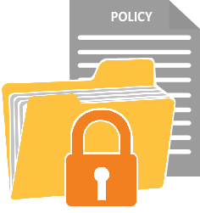
Release Policy
The release policy is the primary strategy for releases and is derived from the Service Design phase of the service lifecycle. The policy includes the following:
Release description;
The roles and responsibilities at each stage of the process;
The expected frequency for each kind of release;
The approach taken to accept and group changes into a release; and
Use of automation for release and deployment.

Slide 53
Release Policy (contd.)
Following are some more components of the release policy:
How the configuration baseline for the release is captured and verified against the contents of the actual release;
Entry and exit criteria and authority for accepting the release at each stage of service transition; and
Criteria and authorisation to exit early life support and handover to service operations.

Slide 54
Types of Releases
Following are the release types:
Release Types
Major release
Minor release
Emergency release
Supersedes preceding minor upgrades
Supersedes previous emergency fixes
Linked to an emergency change

Slide 55
Release and Deployment Approaches
The most frequently occurring options for the rollout of releases are big bang versus phased, push versus pull and automated versus manual approaches. Given below are the facts related to big bang and phased approach:
Big Bang
Phased
Refers to the new or changed service deployed to all user areas in one operation.
Used when introducing an application change and consistency of service.
Service is deployed to a part of the user base initially.
Operation is repeated for subsequent parts of the user base.

Slide 56
Release and Deployment Approaches (contd.)
Given below are the facts related to push and pull approaches:
Push
Pull
Service component is deployed from the center and pushed out to the target locations.
Used for software releases.
Users are free to pull the software available in a central location.

Slide 57
Release and Deployment Approaches (contd.)
Given below are the facts related to automated and manual approaches:
Automated
Manual
Refers to automating releases using technology.
Ensures repeatability and consistency.
Refers to distributing a release manually.
Monitors and measures the impact of many repeated manual activities.

Slide 58
RDM Phases
The four phases in RDM are release and deployment planning, release build and test, deployment and review and close.
Release and deployment planning
Release, build and test
Deployment
Review and close
This phase starts with change management authorisation to plan a release and ends with change management authorisation to create the release.
This phase starts and ends with change management authorisation to build the release and ensure that the baseline release package is checked into the DML.
This phase starts with change management authorisation to deploy the release to the target environment, and ends with handing it over to the service operation function.
This is the last phase where experience and feedback are captured, performance targets and achievements are reviewed.

Slide 59
RDM Phases (contd.)
The image shows the four phases included in Release and Deployment Management.
Change Management
Auth
Auth
Auth
Auth
Authorize
Release
Planning
Authorize
Build and
Test
Authorize
Check-in to DML
Authorize
Deployment/Transfer/Treatment
Release and
Deployment
Planning
Release, Build and
Test
Deployment
Review and
Close
Deployment
Auth
Transfer
Retirement
Change Management Authorization
© Crown Copyright 2011. Reproduced under licence from AXELOS.

Slide 60
Release Management—Example
Q
A small organisation has the following Configuration Items (CIs): 10 Windows and 2 email servers, 20 switches, 5 routers, 2 video conferencing units. The two email servers (server 1 and server 2) are the parents for the routers, namely, router 1 and router 2, which are parents for all the switches. The remaining servers and routers are serving for a different service. There is a firmware upgrade requested by the server team on the server. The flowchart shows how release management is implemented.
Logged
Initial validation
CR is passed to release
Release is raised
Release is logged
Release validates the inputs
Testing
Test environment prepared
Patched is tested in test environment
Pass/fail
Risk management
Risk mitigation
Remotely hard reboot the server
Compatible issues validated in test
Business impact
BI during release
All the email users will be affected
Release implemented after business hours
Stakeholder communication
Release calendar prepared
Communicated to stakeholder
Release calendar approved
Release finalisation
Approval from Release Manager
Approved
Date finalised for release
Release implementation
Release communicated to clients
Resources allocated
Release implemented
Release verification and closure
CHM verifies the release
Release successful
CR is closed

Slide 61
Introduction to Knowledge Management
The ability to deliver a quality service or complete a process depends on the understanding of the situation, consequences and benefits, which is collectively called the knowledge of that situation.
Facts related to knowledge management:
Knowledge management provides support for the capture and effective publishing of knowledge of a situation in which a service is offered.
The quality and relevance of the knowledge rests on the accessibility, quality and continued relevance of the underpinning data available to the service staff.

Slide 62
Knowledge Management—Purpose
Knowledge management is significant within service transition phase because testing and validation data is gathered in this phase prior to release into the live environment.
The purpose of knowledge management is to:
share perspectives, ideas, experience and information; and
ensure that the information is available in the right place and at the right time.
Purpose
Objective
Scope

Slide 63
Knowledge Management—Objective
The objective of knowledge management is to:
improve the quality of management decision-making;
ensure that the right information is delivered to the appropriate place or person at the right time; and
maintain a SKMS that offers controlled access to information, knowledge and data.
Purpose
Objective
Scope

Slide 64
Knowledge Management—Scope
The scope of knowledge management is to:
provide knowledge throughout the service lifecycle; and
manage knowledge, information and data on identity of stakeholders, available timescales or resources and so on.
Purpose
Objective
Scope

Slide 65
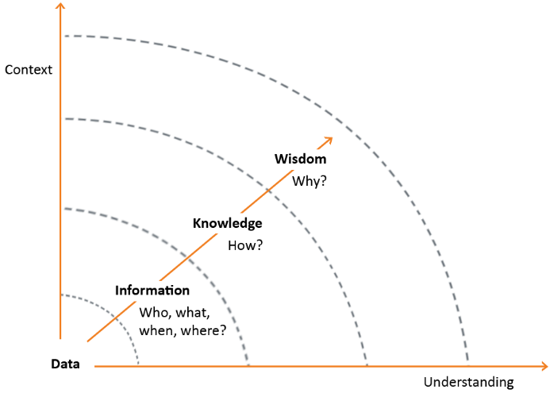
Data-Information-Knowledge-Wisdom
Data-Information-Knowledge-Wisdom (DIKW) is the heart of knowledge management. Effective sharing of knowledge requires the development and maintenance of SKMS.
Some facts related to DIKW are given below:
Data is a set of discrete facts.
Information requires applying meaning or relevance to the set of facts.
© Crown Copyright 2011. Reproduced under licence from AXELOS.

Slide 66
Data-Information-Knowledge-Wisdom (contd.)
Following are some more facts related to DIKW:
Knowledge is composed of the experiences, ideas, insights and judgments from individuals.
Wisdom helps an organisation to direct its strategy and growth in competitive market spaces.

Slide 67
Summary
The purpose of the transition, planning and support process is to provide overall planning for service transitions.
Change management covers changes to baselined service assets and configuration items across the service lifecycle.
Service Asset and Configuration Management provides the information required to manage CIs and assets across the service lifecycle.
The purpose of RDM is to plan, schedule and control the build, test and deployment of releases.
Knowledge management ensures that the information is available in the right place and at the right time.
Here is a quick recap of what we have learnt in this lesson:

Slide 69
Which of the following statements about a standard change is incorrect?
1
A standard change is a low-risk change
Standard changes are pre-authorised changes
Standard changes are authorised by E-CAB
Standard changes are well known, documented and proven

Slide 70
Which of the following statements about a standard change is incorrect?
1
A standard change is a low-risk change
Standard changes are pre-authorised changes
Standard changes are authorised by E-CAB
Standard changes are well known, documented and proven
Answer: c.
Explanation: Emergency changes are authorised by E-CAB.

Slide 71
Which of the following statements about the relationship between CMS and SKMS is correct?
2
The SKMS is a part of the CMS
The CMS is a part of the SKMS
There is no relationship between the CMS and SKMS
The CMS and the SKMS are the same

Slide 72
Which of the following statements about the relationship between CMS and SKMS is correct?
2
The SKMS is a part of the CMS
The CMS is a part of the SKMS
There is no relationship between the CMS and SKMS
The CMS and the SKMS are the same
Answer: b.
Explanation: CIs are part of CMDB, CMDB is part of CMS and CMS is part of SKMS.

Slide 73
Which of the following is an activity of SACM?
3
Account for all the financial assets of an organisation
Specify the relevant attributes of CI
Implement ITIL® across the organisation
Design service models to justify ITIL® implementations

Slide 74
Which of the following is an activity of SACM?
3
Account for all the financial assets of an organisation
Specify the relevant attributes of CI
Implement ITIL® across the organisation
Design service models to justify ITIL® implementations
Answer: b.
Explanation: Service Asset and Configuration Management process includes and maintains the configuration items (CIs) which are relevant to IT service.

Slide 75
Service transition provides guidance on __________.
4
Moving new and changed services to production
Controlling the lifecycle of all changes
Releasing and deploying the services
Designing service models

Slide 76
Service transition provides guidance on __________.
4
Moving new and changed services to production
Controlling the lifecycle of all changes
Releasing and deploying the services
Designing service models
Answer: a.
Explanation: Service transition provides guidance on moving new and changed services to production.

Slide 77
Which of the following is an incorrect release and deployment approach?
5
Propagate and consolidate
Push and pull
Big bang and phased
Automated and manual

Slide 78
Which of the following is an incorrect release and deployment approach?
5
Propagate and consolidate
Push and pull
Big bang and phased
Automated and manual
Answer: a.
Explanation: Propagate and consolidate is not the release and deployment approach, whereas the other three are.

